Slide 1
Employee Engagement Improvement
Albert Karam Raunak Kshatriya Quang Lam Palakk Shrivastava Rohan Bhagi

Slide 2

Company Overview
Background
The Problem
Approach
Solution
Type: Non Profit Research and Development Company in Healthcare
Goal: Use machine learning and AI to help patient outcomes
Size: 40-50 employees

Slide 3

Employee Engagement
Background
The Problem
Approach
Background
The Problem
Approach
Solution
The Situation
Previous Approach
The Ask
Framed Question
The same 40 Question Survey was given to all employees at a >95% participation rate
2017
2018

Slide 4
Satisfaction ≠ Engagement
Background
The Problem
Approach
Solution
The Situation
Previous Approach
The Ask
Framed Question
Employee satisfaction or job satisfaction is, quite simply, how content or satisfied employees are with their jobs. (Custom Insights 2018)
Satisfaction doesn't mean high performance or engagement. (Custom Insights 2018)
Employee engagement is the level of commitment, passion, and loyalty a worker has toward their work and company. The more engaged an employee is, the more work they'll put forth (Kapple 2018)

Slide 5
Previous Approach After 2017 Survey
Background
The Problem
Approach
Solution
The Situation
Previous Approach
The Ask
Framed Question
Raising the Bar Award (Monthly Recognition)
Monthly Newsletter
Virtual Friday’s
Additional Paid Holidays
Benefits Training
Creating Employee Engagement Committee
Notes:
Employee Engagement Definitions (and citations)
Employee engagement is the extent to which employees feel passionate about their jobs, are committed to the organization, and put discretionary effort into their work (Custom Insights 2018)
OR
Employee engagement is the level of commitment, passion, and loyalty a worker has toward their work and company. The more engaged an employee is, the more work they'll put forth (Kapple 2018)

Slide 6
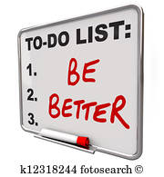
The Ask
Background
The Problem
Approach
Solution
The Situation
Previous Approach
The Ask
Framed Question
Examine the Survey
What Can We Do Better?
3rd Party Perspective

Slide 7
Background
The Problem
Approach
Solution
The Situation
Previous Approach
The Ask
Framed Question
Recognition
Internal and External Recognition based on Meritocracy
Trust
Are there opportunities to improve trust in both directions?
Improve Employee - Senior Management Relationship
Communication
While there were previous improvements, can we provide more effective communication solutions?

Slide 8
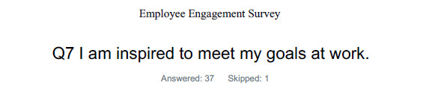
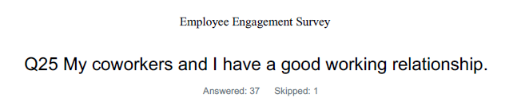
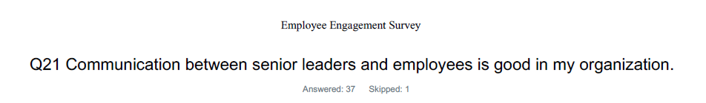
Background
The Problem
Approach
Solution
Survey Results
Approach to Solution
Examining the results of both surveys we identified 3 main categories of questions -
Employee Growth
2. Employee to Employee Relations
3. Employee to Organization Relations

Slide 9
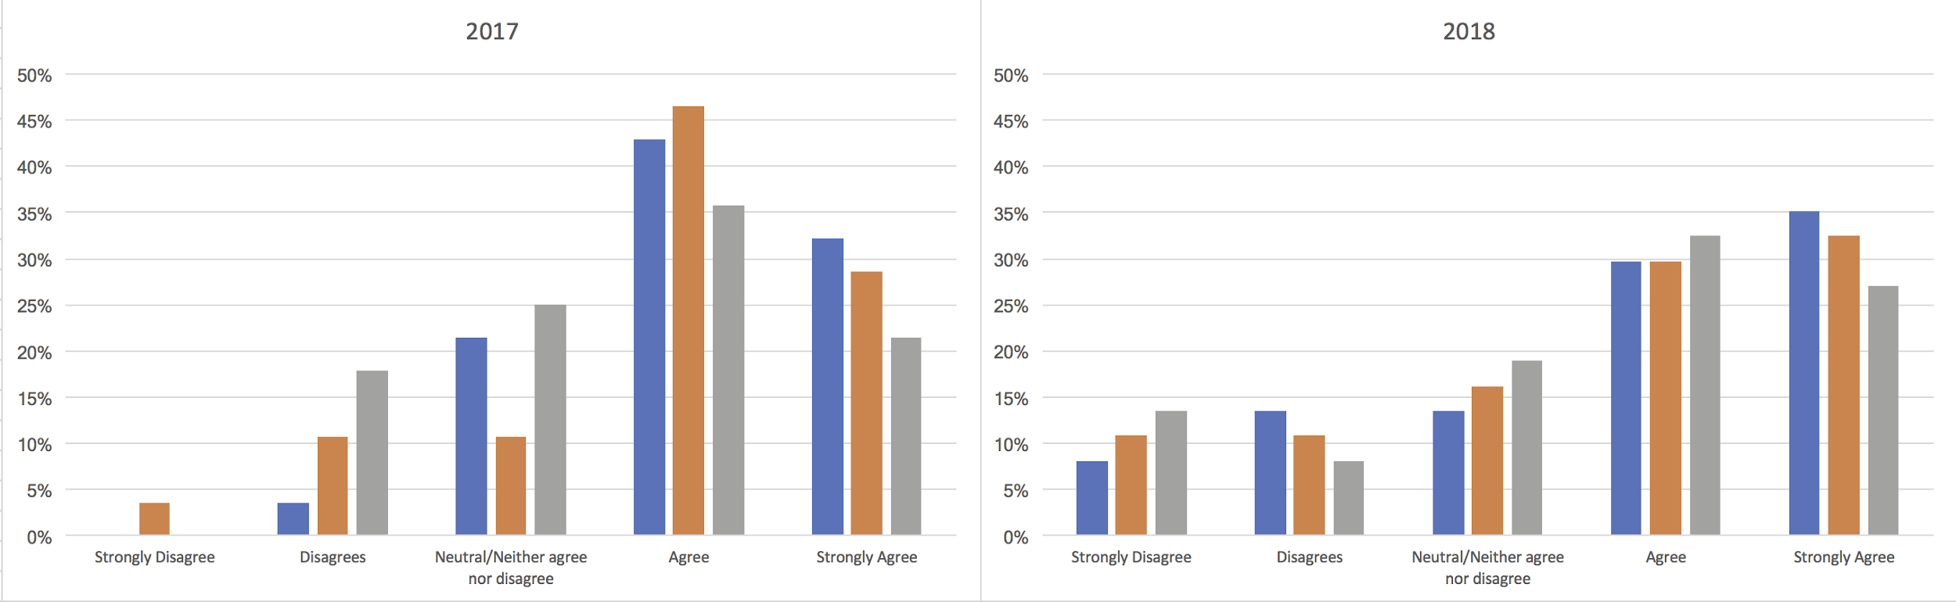
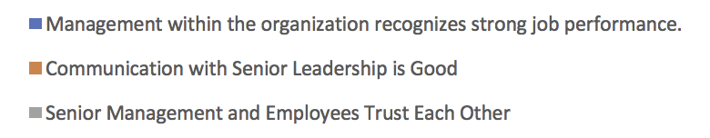
Background
The Problem
Approach
Solution
Survey Results
Approach to Solution

Slide 10
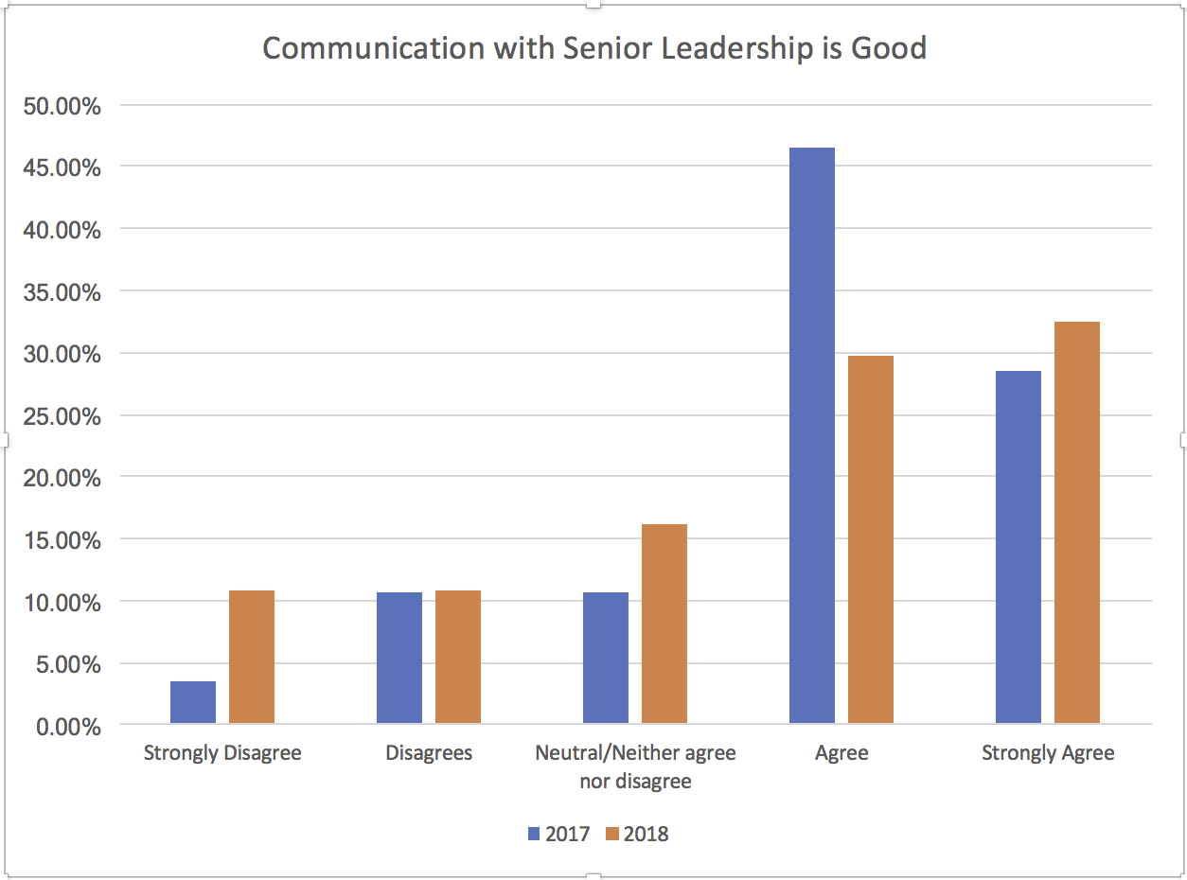
Background
The Problem
Approach
Solution
Survey Results
Approach to Solution
We analyzed the survey results from 2017 and 2018 and found that highest percentage of disagree/strongly disagree were in the category 3 questions: Employee to Organization Relation.
There is a digression between Management and the Employees and potential for an improvement of the culture.
Notes:
If you give a man a mask, he’ll show you his true colors, heath ledger as the joker
Inspiration for anonymity

Slide 11
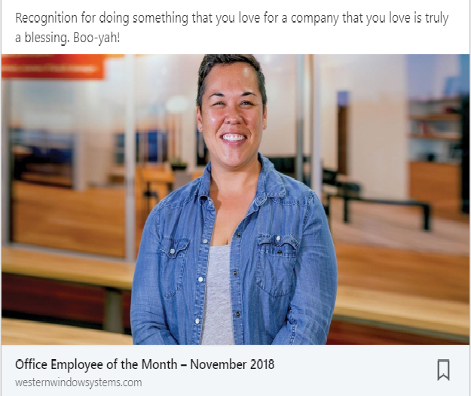
Background
The Problem
Approach
Solution
01
Building Trust
Solution
Take blame, give credit: Increase accountability and praise. (HBR 2014)
Emphasize what you have in common - help ensure goals are aligned. (HBR 2014)
Encourage over Command: Offer freedom by minimizing micromanagement of employees. (Forbes 2017)
Provide an opportunity to manage their own activities. (Forbes 2017)

Slide 12
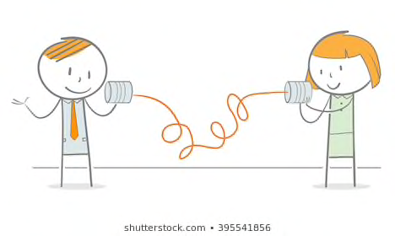
Background
The Problem
Approach
Solution
02
Communication
Solution
Keep a quarterly log of employee accomplishments to track progress, providing more frequent feedback.
Create a “KUDOS” column in the department newsletter
“Create loops of feedback so people can see how their suggestions are implemented” (Baldoni 2008)
Notes:
https://hbr.org/2008/03/the-three-rules-of-employee-en
Communicate. Keep employees in the loop about what is going on. Take time to discuss what is going right as well as what needs to improve. Invite employees contribute suggestions for improvement. Create loops of feedback so people can see how their suggestions are implemented. Management is under no obligation to implement every suggestion from every employee, but keeping people apprised of the status of their suggestions is critical.

Slide 13


Background
The Problem
Approach
Solution
03
Recognition
Solution
INTERNAL
Meritocracy (Whitehurst 2014)
Recognize employees based on their accomplishments and achievements more frequently and positively
EXTERNAL
Take to social media postings on individual and company accomplishments
Review and comment on the research papers published by employees and leaders
Notes:
https://hbr.org/2008/02/are-you-using-recognition-effe-1.html

Slide 14
References
Baldoni, John. March 26, 2008. HBR. https://hbr.org/2008/03/the-three-rules-of-employee-en. Date Access. 12/03/2018. Custom Insights 2018, What is Employee Satisfaction?, https://www.custominsight.com/employee-engagement-survey/what-is-employee-engagement.asp, Date Accessed 11/06/2018. Forbes, Forbes Coaches Council. April 28, 2017. 12 Ways Managers Can Establish A Trusting Relationship With Employees. https://www.forbes.com/sites/forbescoachescouncil/2017/04/28/12-ways-managers-can-establish- a-trusting-relationship-with-employees/#4e056cc9c297 . Date Accessed 12/02/2018. HBR, Carolyn O’Hara. June 27, 2014. Proven Ways to Earn Your Employees Trust. https://hbr.org/2014/06/proven-ways-to-earn-your-employees-trust. Date Accessed 12/02/2018.
Harter, Jim August 26, 2018, Employee Engagement on the Rise in the U.S., https://news.gallup.com/poll/241649/employee-engagement-rise.aspx, Date Accessed 11/06/2018.
Kapple, Mike, January 04, 2018, Forbes Contributor, How To Establish A Culture Of Employee Engagement,
https://www.forbes.com/sites/mikekappel/2018/01/04/how-to-establish-a-culture-of-employee-engagement/ #22238b548dc4 , Date Accessed 11/06/2018. Whitehurst, Jim. October 2014. Wired. Meritocracy: The Workplace Culture that Breeds Success. https://www.wired.com/insights/2014/10/meritocracy/ Date Accessed 12/03/2018.

Slide 15
Appendix

Slide 16
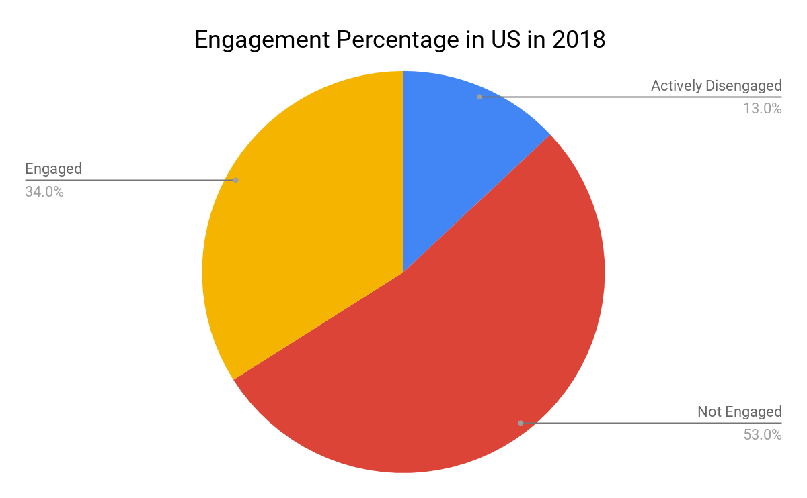
How Engaged are Employees in the US?
Results based on a random sample of 30,628 full- and part-time U.S. employees working for an employer from January to June 2018.
“Organizations and teams with higher employee engagement and lower active disengagement perform at higher levels.”
(Harter 2018)

